Slide 1

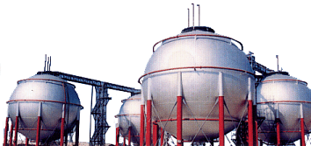
CTY CONG NGHIEP KHI HOA LONG VIET NAM
VINA LPG CO., LTD
G1- House 12/1, Str Truong Dinh, Dist.3, HCM Vietnam
Tel: 848-9301308 Fax: 848-9301661
Email: vinalpg@hcm.fpt.vn

Slide 2
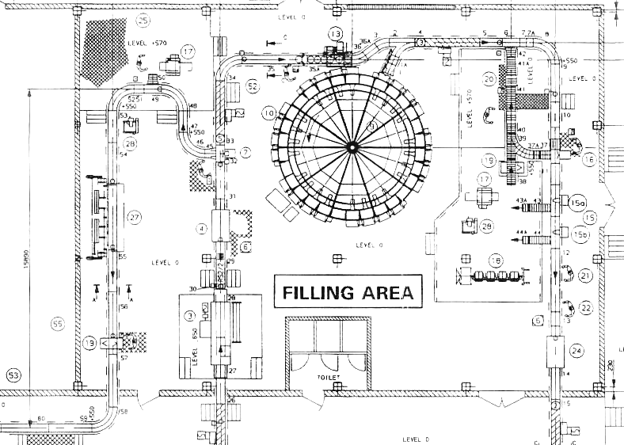
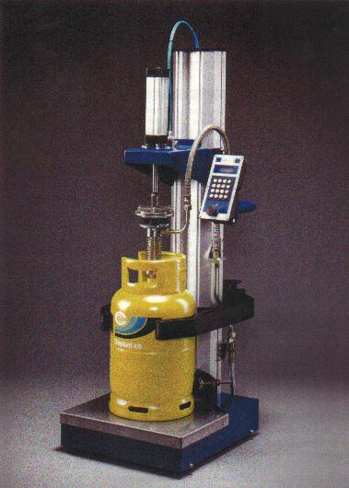
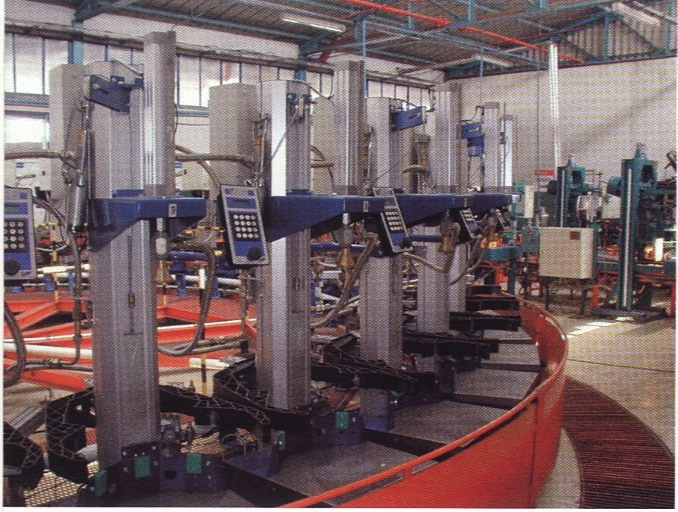
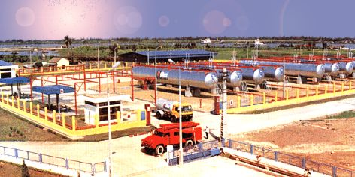
Provide total solution to gas terminal
and plant requirement.
Over 10 years experience on building of
LPG bottling plant.Including total turnkey
project or supply, installation and
commission of complete plant Equipment.
Total Solution for customer need…
We supply from a single piece of equipment to complete plant
including storage tank equipment, flow measuring, filling equipment,
Pipes, fitting and valve, fire safety and gas monitoring system….etc

Slide 3
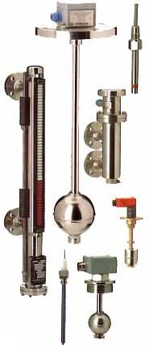
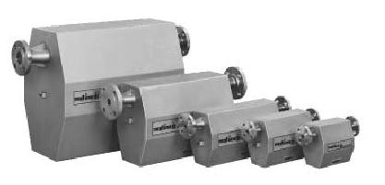
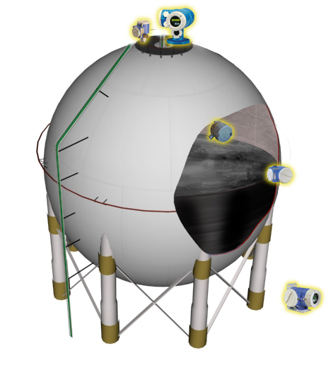
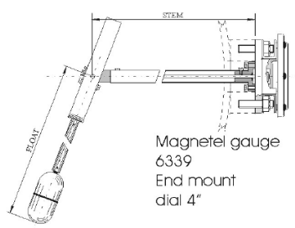
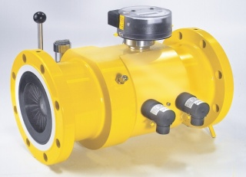
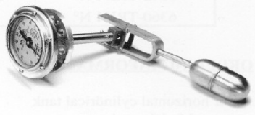
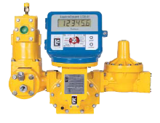
Measuring Equipment.
We provide solution for measuring including liquid level,
flow, temperature, pressure monitoring in your terminal.
Including LPG, Industrial Gases, Diesel and Petroleum ..etc
Level gauges
Coriolis mass meter
Sphere tank measuring
Proservo
Prothermo
Turbine meter
Spot Temperature
Pressure
PD meter
Promonitor

Slide 4
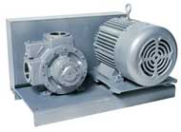
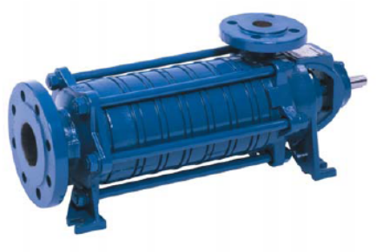

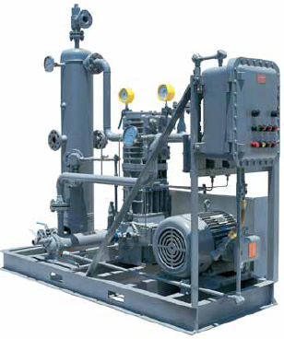
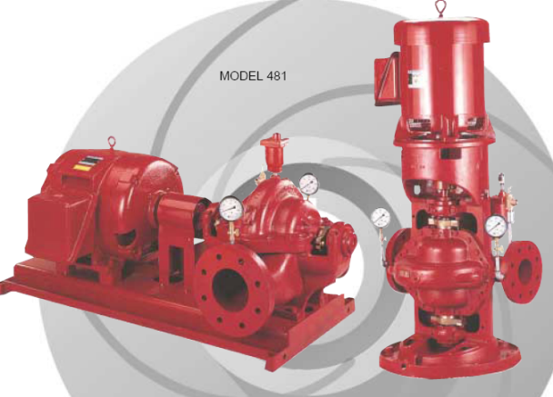

Liquid Transfer Pump and Compressor system.
VINA LPG provide solution for Liquid transfer requirement
Including LPG, Industrial Gases (N2, Ammonia), Diesel and Petroleum ..etc
VINA LPG experience on supply installation and maintenance
of pump and compressor. We can help in selection of pump
and compressor for each application in the plant.
We ensure your plant operation are the most efficient
and beneficial One.
Fire water
pump
Compressor for ship unloading

Slide 5
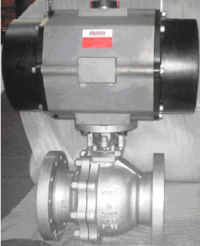
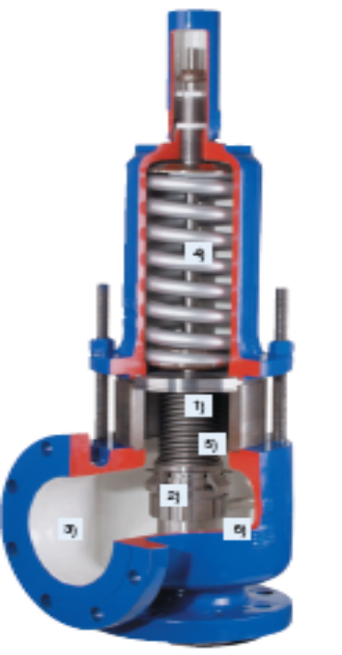
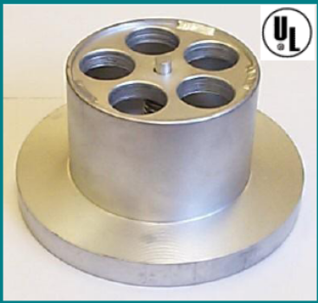
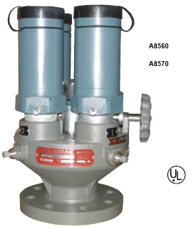
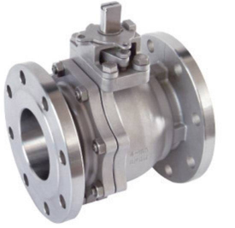
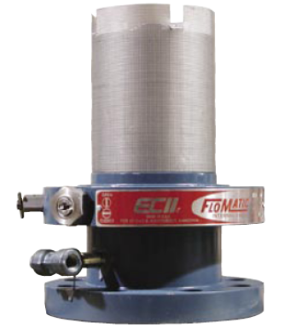
Safety Equipment for Storage tank
Our safety equipment including:
Pressure relief valve (PRV), Emergency shut off valve (ESV),
Excess flow valve (EFV)…etc.
Rofi ESV
Bopp & Reuther
PRV
Rego EFV
Rego PRV
Internal valve

Slide 6
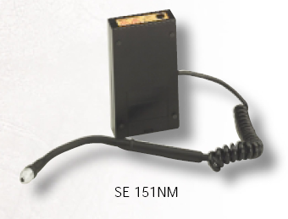



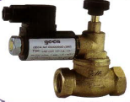
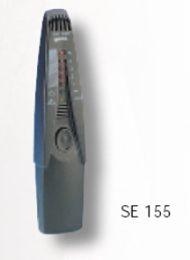
Safety Equipment
Gas leak detecting equipment from portable detection to
multi points detecting system.
For Methane, LPG, CO….etc
Multi points detection system
Portable Gas detector
City with max. 16 sensors head
Alarm
LPG Tank 1
LPG Tank 2
LPG Tank 3
Pump shed
Tuck loading area

Slide 7
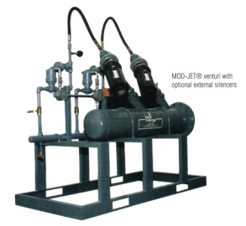
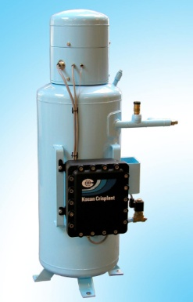
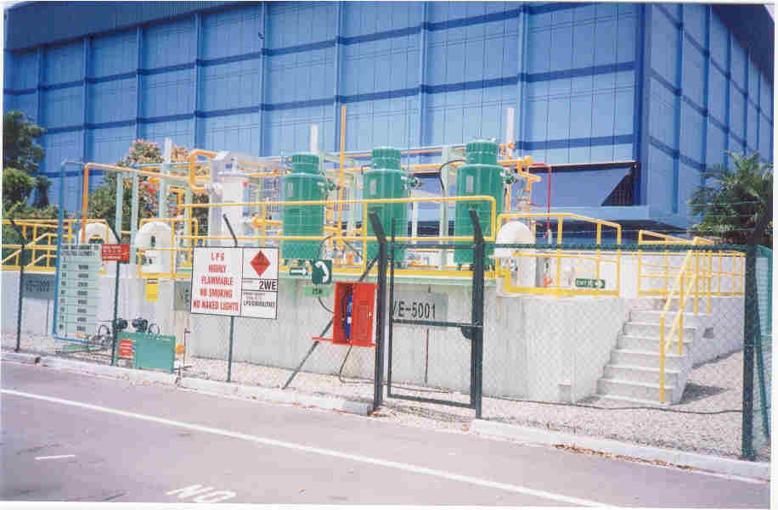
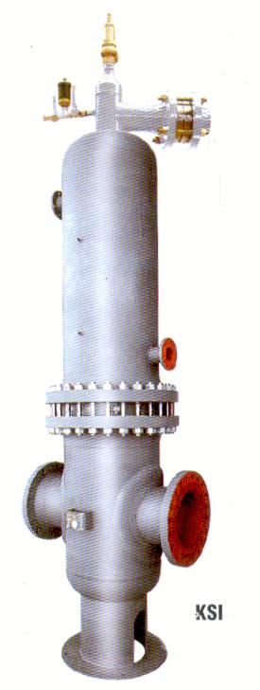
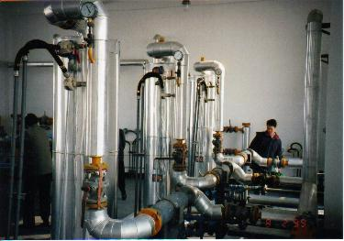
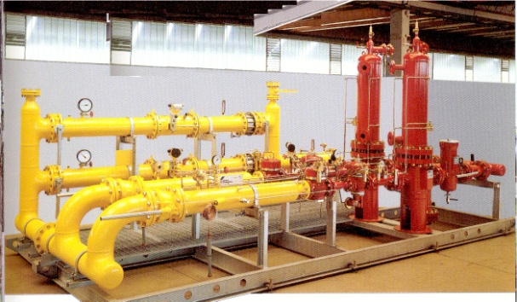
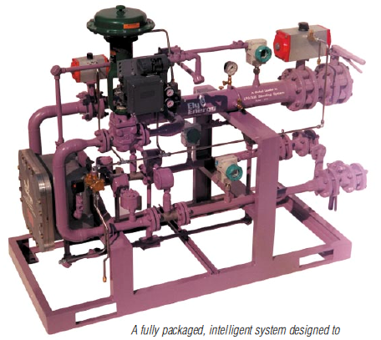
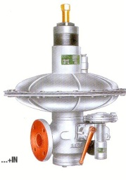
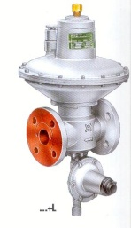
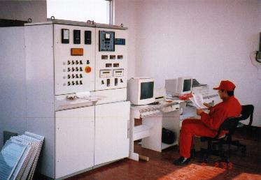
Industry and Housing Estate
Gas Supply System.
VINA LPG have wide range of related product on gas reticulation system.
. LPG reticulation system related product including vaporizer, regulator,
water heater….etc.
. LPG/air mixing system design for industry and housing estate which
prepare for future natural gas line supply.
. Natural gas regulating station, metering station….etc.
The strategy of the company has focus on developing new system
together with our customer.
Our widespread network of sales and contact around the world,
able us to gather professional in different field to satisfy
customer need.

Slide 8
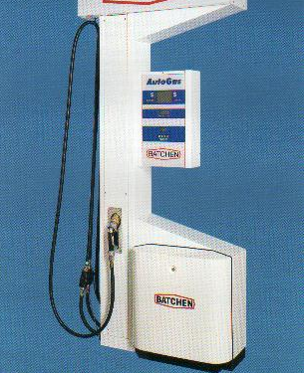
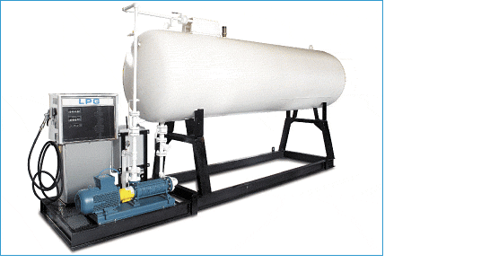
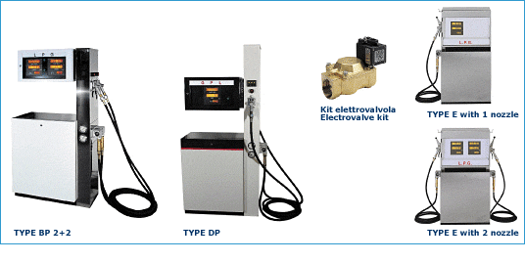
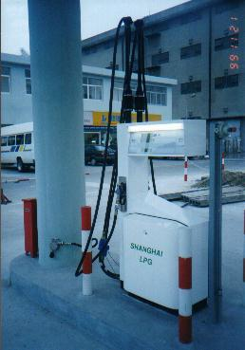
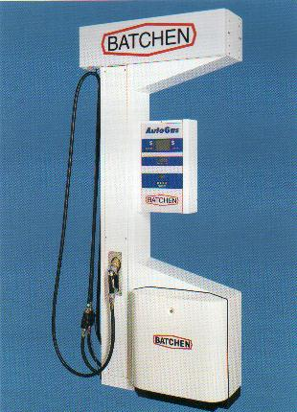
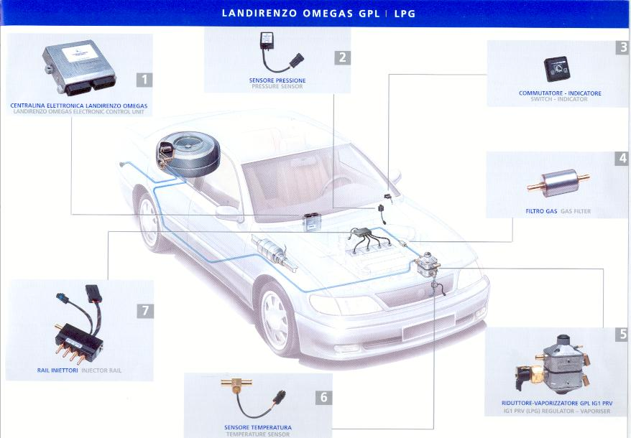
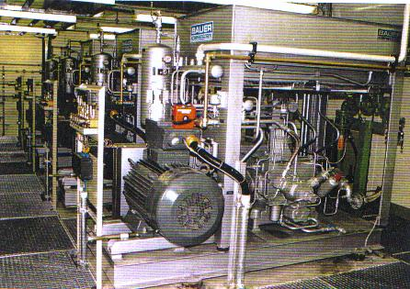
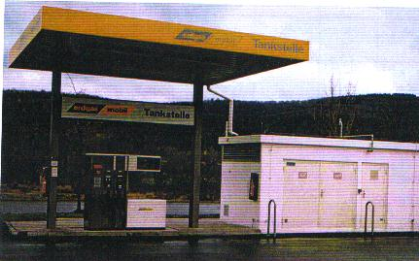
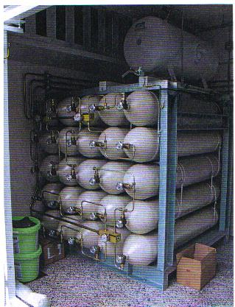
Automotive equipment running with Gas
We supply complete system for Natural gas and LPG dispenser
And automotive conversion System for vehicles.
Product including Batchen, Semtech dispenser, Landi Renzo
Conversion kit are the most well known product in the world’s.
Bauer Kompressor from Germany for CNG refilling station.
A unique installation, generates eco-friendly conversion system
because it constantly meets the technology, commitment and
Attention to customer needs.
BAUER
KOMPRESSOREN

Slide 9
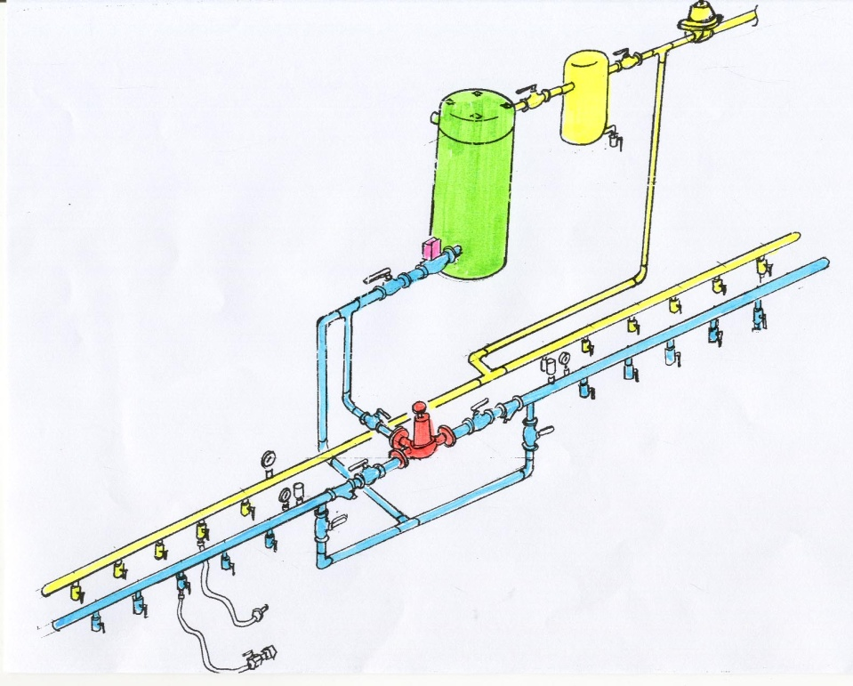
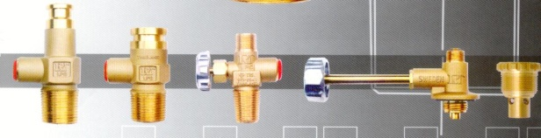
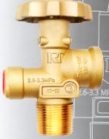
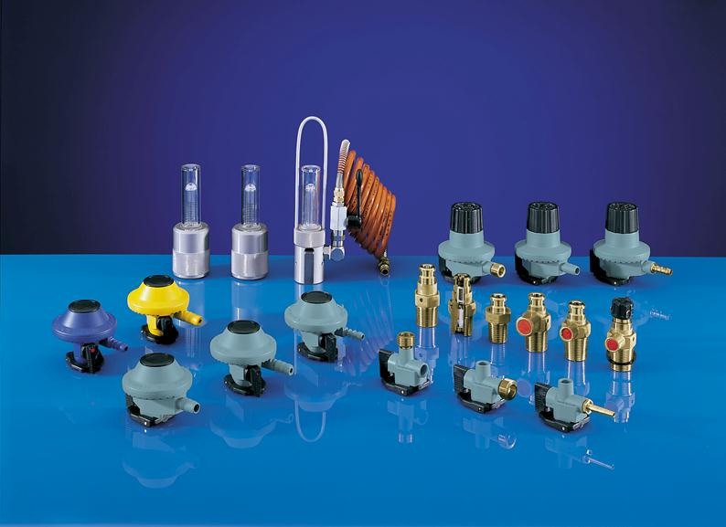
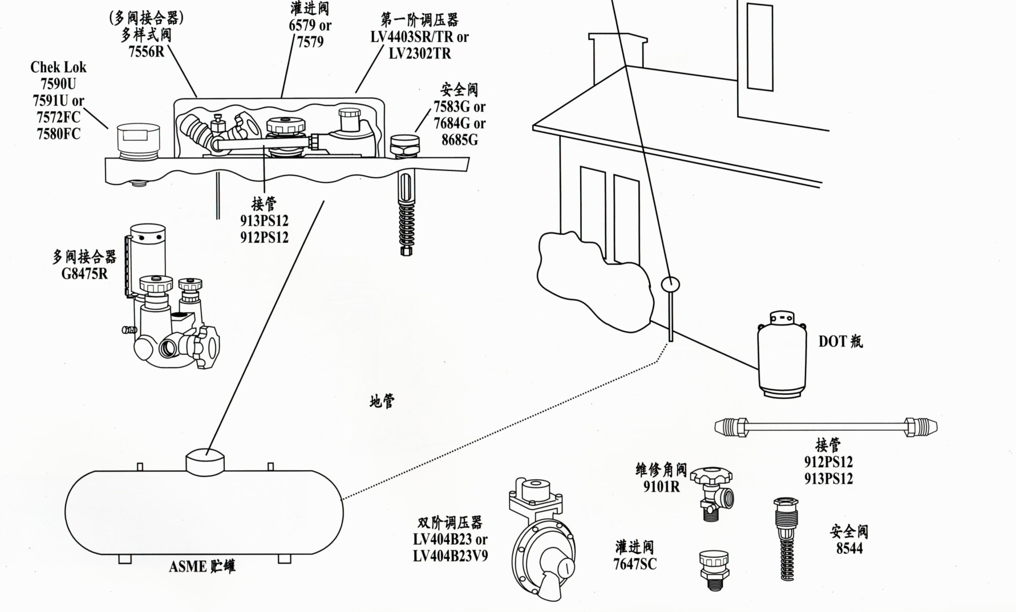
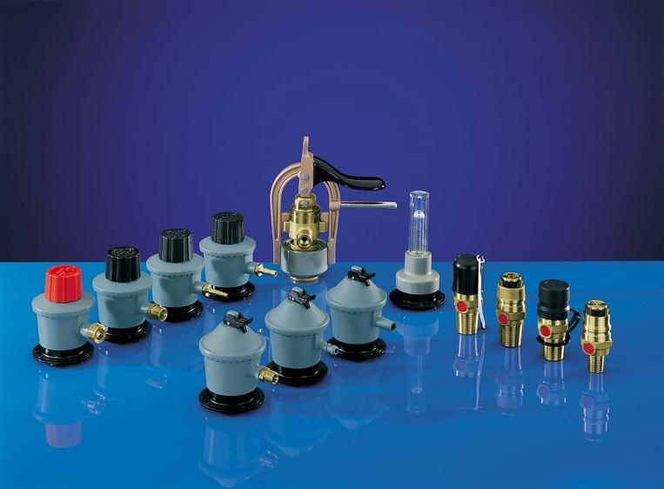











Accessories..
Tank fitting, Industrial and Domestic products.
Total Solution for customer need……………..
To enable us to achieve total solution, VINA LPG are also supply
Tank fitting like Rego safety relief valve, emergency shut off valve
Break away coupling …etc.
Cylinder valve from Comap France, SRG Germany or RT Thailand
House hold product including SRG domestic regulator,
Comap domestic regulator, flow meter ……etc.
We believe in serving our customer from one item to a complete
Plant equipment.
Nothing are too small for us.

Slide 10



VINA LPG Integrated Supplier
VINA LPG is an integrated engineering and supplier, we management your project and ensure in time completion of your project.
Complete LPG terminal
Fire water
pump

Slide 11


















VINA LPG CO., LTD
Total Solution cater to customer need………
G1- House 12/1, Str Truong Dinh, Dist.3, HCM Vietnam
Tel: 848-9301308 Fax: 848-9301661
Email: vinalpg@hcm.fpt.vn

Slide 12

LPG TERMINAL

Slide 13




JETTY
COMPOSITE HOSES
BREAK AWAY COUPLING
MASS FLOW METER

Slide 14


Sphere tank measuring
Proservo
STORAGE TANK
Prothermo
SAFETY RELIEF
VALVE
LEVEL GAUGE
Spot Temperature
Pressure
EXCESS FLOW
VALVE
Promonitor
EMERGENCY
SHUT OFF
VALVE

Slide 15

VANE PUMP
SIDE CHANNEL PUMP
COMPRESSOR

Slide 16





DP MATER
MASS METER

Slide 17





LPG TERMINAL
LOADING ARM
PULL AWAY VALVE
LOADING ARM
ESV

Slide 18

LPG FILLING
Hazardous Area
Filling Carousel
Cylinder
Inspection &
Registration
Valve Orientation Unit
Non Hazardous Area
Check Scale
Leak Detector

Slide 19

FIRE FIGHTING EQUIPMENT
TANK AREA
TRUCK LOADING AREA
PUMP SHED
FIRE WATER
PUMP
FILLING SHED AREA

Slide 20

Description
Design Diesel Engine Pump Duty Required:3500 USGPM @ 7BAR
Diesel Engine Fire Pump Cap. 3500 USGPM @ 7BAR
Standard NFPA20, UL/FM & PSB Approved Standard Single Stage
Driven by "CLARKE" Diesel engine UL/FM Approved
Engine accessories
Fuel tank with fitting accessories
Pump fitting including
- 3-1/2" dia Suction gauge range 30"-0-150 psi
- 3-1/2" dia Discharge gauge range 0-300 psi
- Float - operated air release valve
- Flexible coupling
- Coupling guard
- Enclosed Wastecone 8" x 12"
- Main Relief Valve Pilot Operated 175 Psi Max 125# Inlet Flange 8" x 8"
-Gerand Venturi Flowmeter, Flange End to Ansi Class 125, 3500 GPM, 8"
UL/FM Approved, NFPA 20 Standard "FIRETROL "
Diesel Fire Pump Controller for 12-Volt engine with Lead-acid batteries
-0-600 PSI range pressure transducer
-printer/recorder
Design Electric Jockey Pump Cap. 25m3/h @ 8.3Bar
Standard Vertical Multistages Pump "Paragon"
FIRE FIGHTING EQUIPMENT
TANK AREA
TRUCK LOADING AREA
PUMP SHED
PUMP SHED
FILLING SHED AREA

Slide 21


FIRE FIGHTING EQUIPMENT
TANK AREA
TRUCK LOADING AREA
PUMP SHED
Deluge Valve electrical
or mechanical operated
FILLING SHED AREA

Slide 22



FIRE FIGHTING EQUIPMENT
TANK AREA
TRUCK LOADING AREA
PUMP SHED
Wall Mounted Double Fire Hose
Cabinet
2 Way Controllable Pillar Hydrant
Bulb Sprinkler
FILLING SHED AREA

Slide 23
VINA LPG CO., LTD
CTY CONG NGHIEP KHI HOA LONG VIET NAM
Total Solution cater to customer
need………
G1- House 12/1, Str Truong Dinh, Dist.3, HCM Vietnam
Tel: 848-9301308 Fax: 848-9301661
Email: vinalpg@hcm.fpt.vn

